Slide 1

Picnics Unleashed: Decoding Weather Whims in Mainland Europe
Alina I.

Slide 2
Agenda
Objectives
Data Set and Key Features
Machine Learning Models and Evaluation
Conclusion
Next Steps

Slide 3
Objectives
Machine Learning Model Development and Evaluation:
Develop, train, and fine-tune machine learning models to predict the suitability of a given day for a picnic based on historical weather data. Evaluate the performance of these models using key metrics such as accuracy score.
Picnics Unleashed: Decoding Weather Whims in Mainland Europe

Slide 4
Dataset and key features
For this project, we were equipped with a dataset from European Climate Assessment & Data Set project, which includes weather observations spanning 18 European cities, chronicling data from the late 1800s to 2022. These recordings, encompassing nearly every day, include essential variables like temperature, wind speed, snow, and global radiation, cloud cover, humidity, pressure, precipitation etc.
Addressing Potential Biases:
Although the dataset has a very solid basis, we might deal with potential biases inherent in historical weather data, including issues related to the quality instruments, data recording errors, and calibration challenges. Due to resource constraints, detailed validation, error identification, and calibration management during this phase have been omitted, revisiting these steps will become imperative in the event of suboptimal model performance.

Slide 5
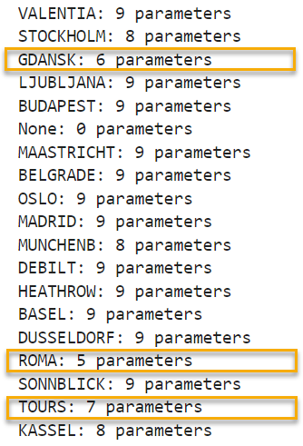
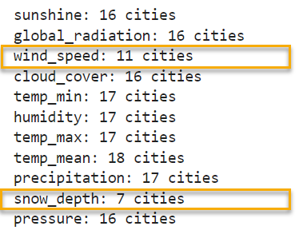
Dataset and key features
After Exploratory Data Analysis phase, it was discovered that three cities—Rome, Gdansk, and Tours—showed insufficient parameters for a comprehensive analysis.
Additionally, certain parameters like wind speed and snow depth were not consistently available across all cities, impacting the overall dataset balance.
As a measure to address this, a decision was made to eliminate these three cities along with two parameters, ensuring a more uniform and robust dataset.

Slide 6
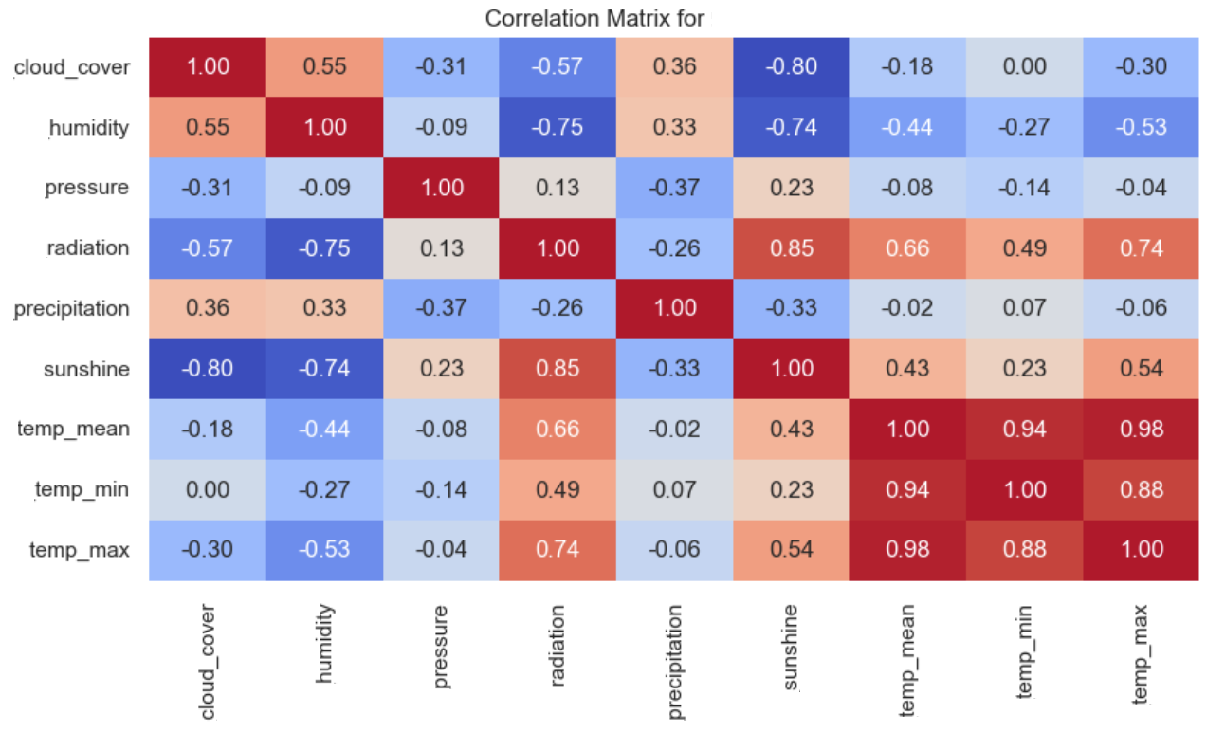
Dataset and key features
Further analysis revealed correlations among specific parameters, namely temp_min, temp_max, sun_shine, and global_radiation. To refine the dataset for effective machine learning, the highly correlated parameters were dropped. This ensures that the analysis focuses on the most influential and independent features for predicting picnic weather accurately.

Slide 7
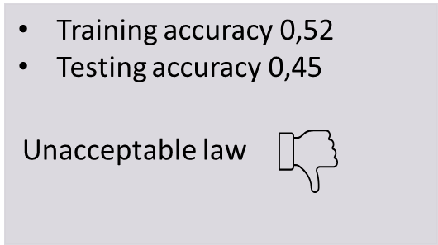
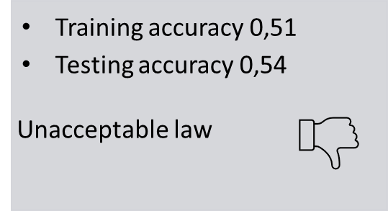
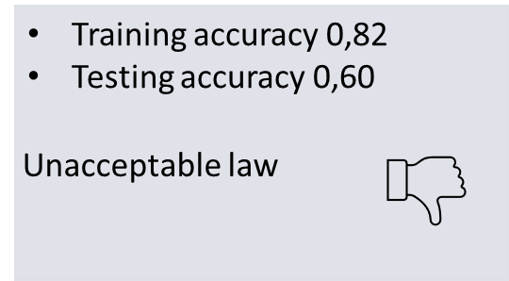
Machine Learning Models and Evaluation
First try: Prediction was done for the entire dataset
KNN
Decision Tree
ANN

Slide 8
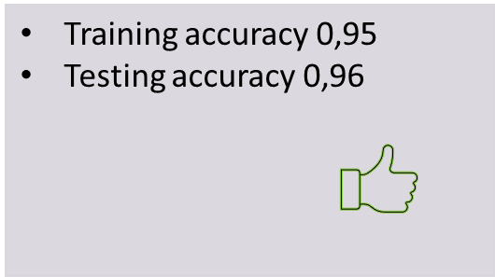
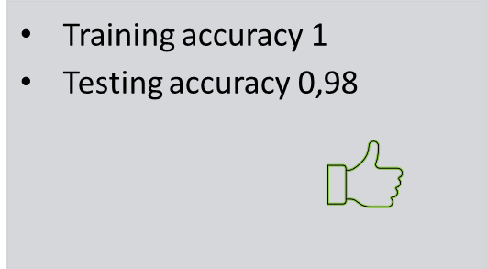
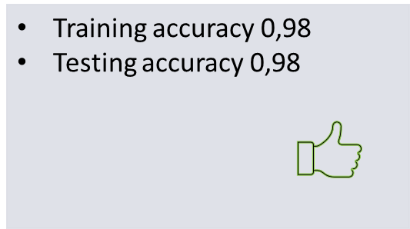
Machine Learning Model Development and Evaluation
Second try: The approach has been changed. The prediction was done for each city separately
Logistic Regression
Decision Tree
ANN

Slide 9
Conclusions
All machine learning algorithms yielded positive results, but the ANN model (98%) and the Decision Tree model (98%) were top performers.
A deep understanding of the dataset proved crucial for achieving optimal performance. Only by fine-tuning our approach were we able to attain these favourable outcomes.
Communication with colleagues played a significant role. A valuable hint regarding Logistic Regression, once received, guided the development of an approach that ultimately led to successful outcomes

Slide 10
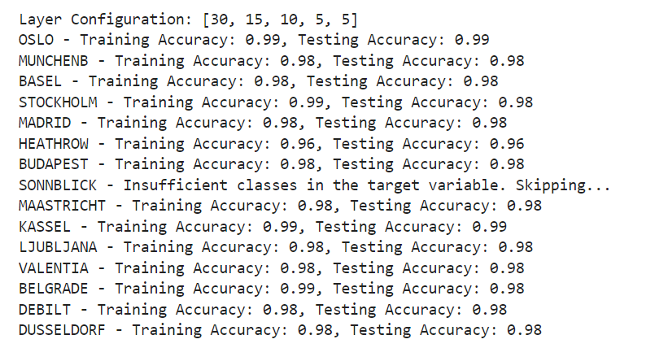
Next steps
Enhancing comprehension of the datasets is imperative, particularly in deciphering the factors contributing to variations in accuracy scores among different cities.
Further refinement of the models is essential to elevate prediction accuracy to higher levels.

Slide 11


Thank you
Alina I.

